Slide 1



VIETNAM NATIONAL UNIVERSITY – HOCHIMINH CITY
THE INTERNATIONAL UNIVERSITY
SCHOOL OF COMPUTER SCIENCE AND ENGINEERING
PRINCIPLES OF DATABASE MANAGEMENT
IT079IU
Topic: Invoice billing database
Instructor: Assoc. Prof. Nguyen Thi Thuy Loan
Present by Group 03

Slide 2


Members
Lê Phan Hồng Huế - ITDSIU23032
Leader
Lê Thị Ngọc Thị Ngọc Tuyền - ITDSIU23028
Member
Nguyễn Thị Diễm Quỳnh- ITDSIU23021
Member
Đặng Nhân Hòa - ITITIU21205
Member
Võ Phúc Khang - ITCSIU23012
Member

Slide 3

Table of content
1.Introduction
2.Database Design
3.Application project structure
4. Conclusion

Slide 4
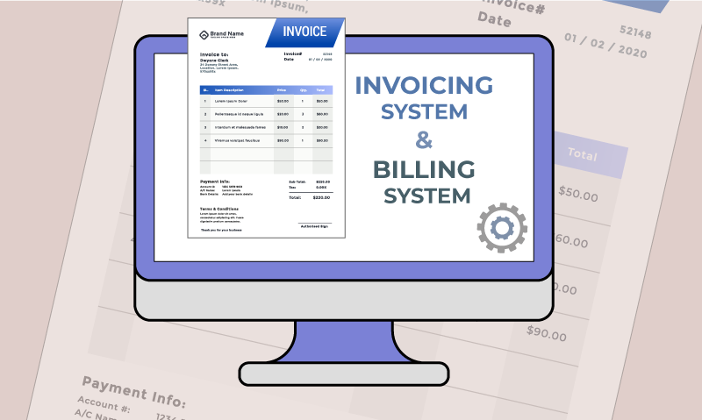

INTRODUCTION
The Invoice Billing Database project aims to develop a streamlined system for shopping complexes and retail stores to generate, manage, and track invoices efficiently.
It organizes price lists, includes keyword recognition for better user interaction, and maintains detailed records of contacts, products, and invoice items for accurate billing and customer communication.

Slide 5




1.1 OBJECTIVES
Design the database to suit the requirements of Normalization BC Normal Form
Connect the front-end interface (application) to the back-end database
Develop the functions
Ensure robust privacy for the
users' data

Slide 6
1.2 TECHNIQUE AND TOOLS
ERDplus
VSCode
MySQL
SQL Server
NetBeans - Java Swing

Slide 7

1.3 Requirement
● Product Information Management
● Efficient User Interaction
● Customer Data Management
● Database Design
● Invoice Management System
● Query and Performance Optimization
● Price List
● Notification System
● Keyword Recognition Feature
● Personalized User Experience
● Payment Information
● System Objectives

Slide 8
2.Database design

Slide 9
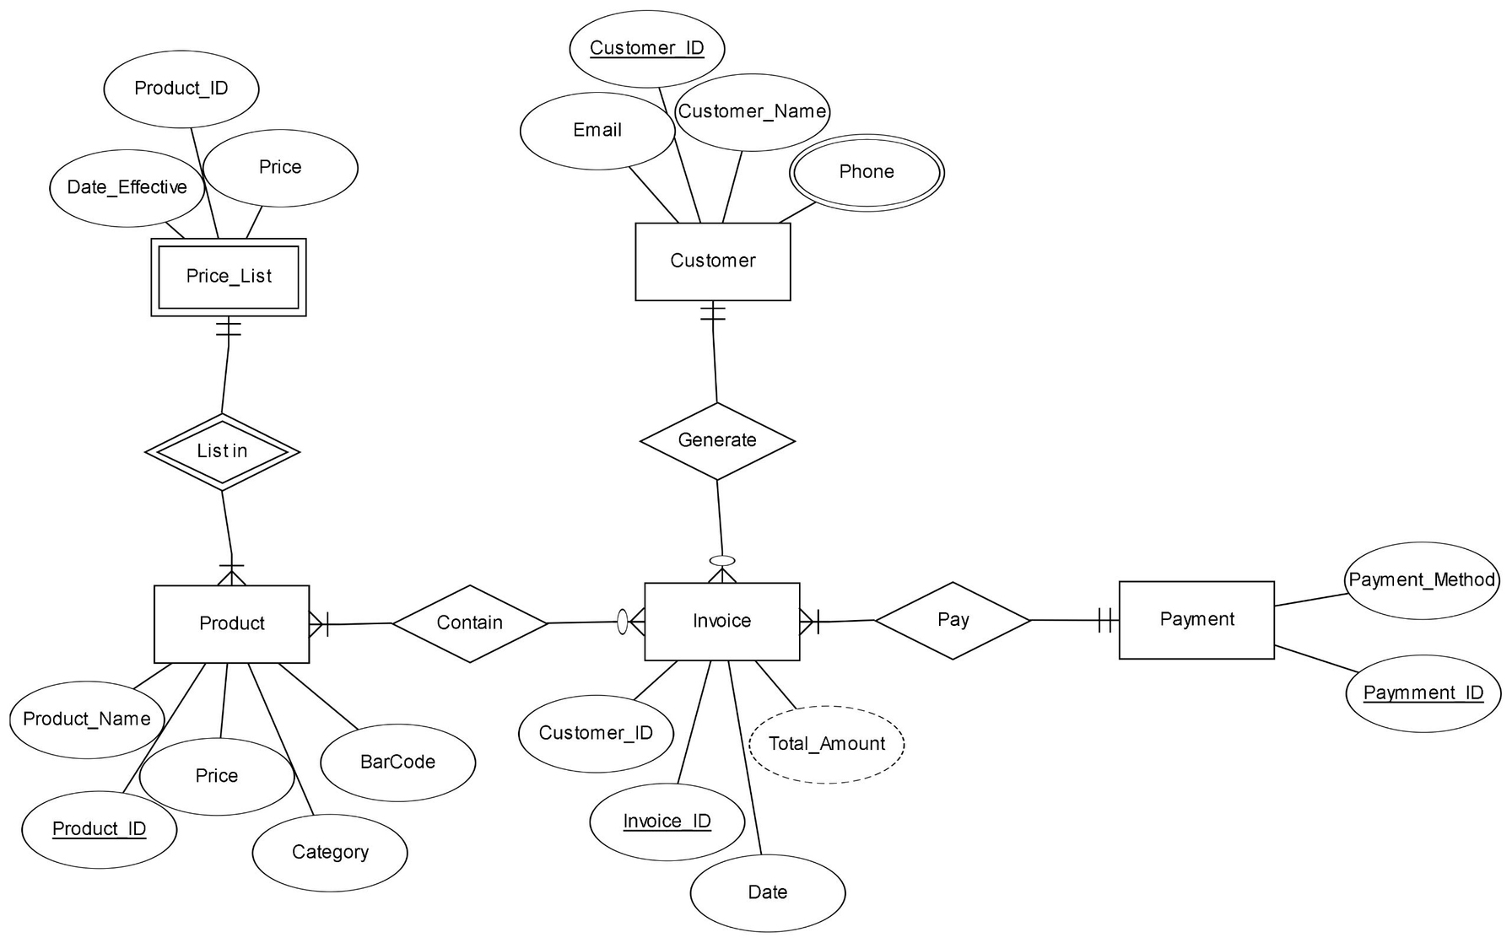
2.1 ERD

Slide 10
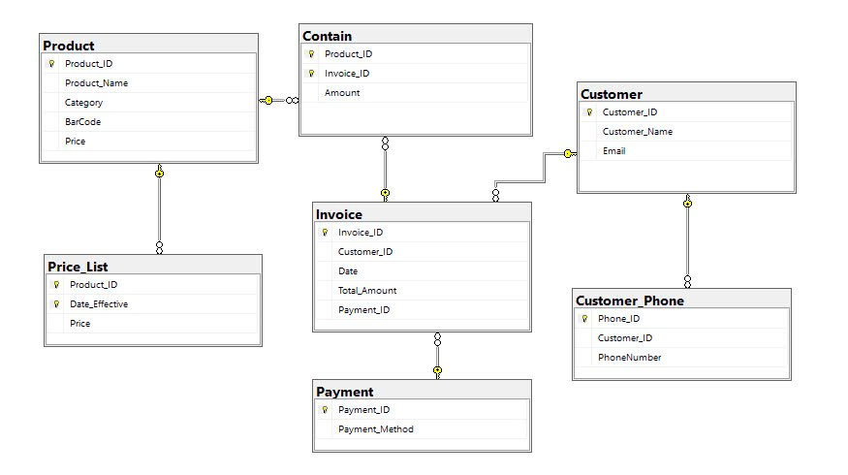
2.2 SCHEMA

Slide 11
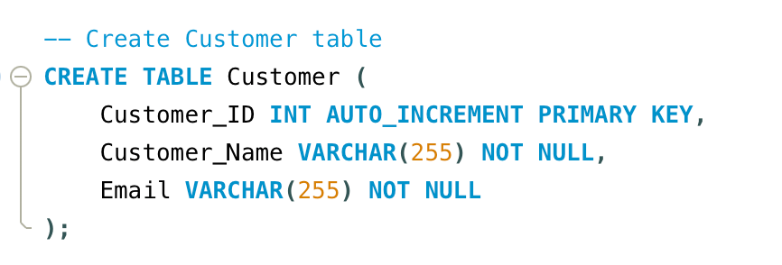
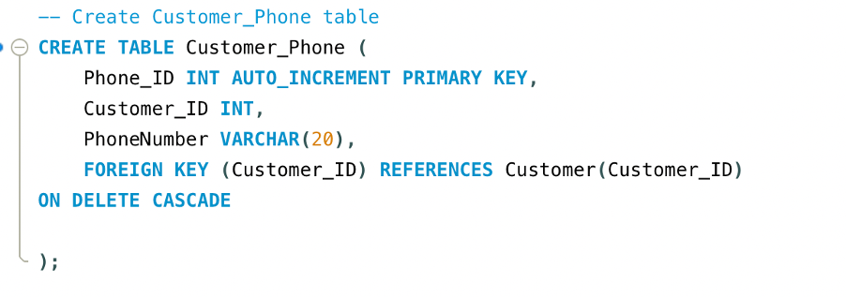
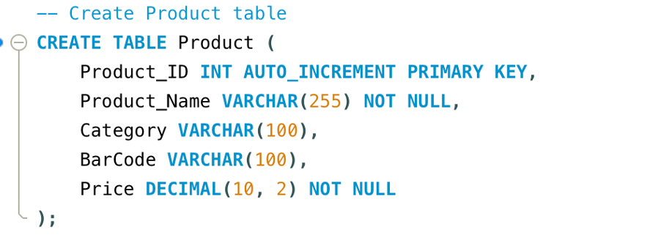
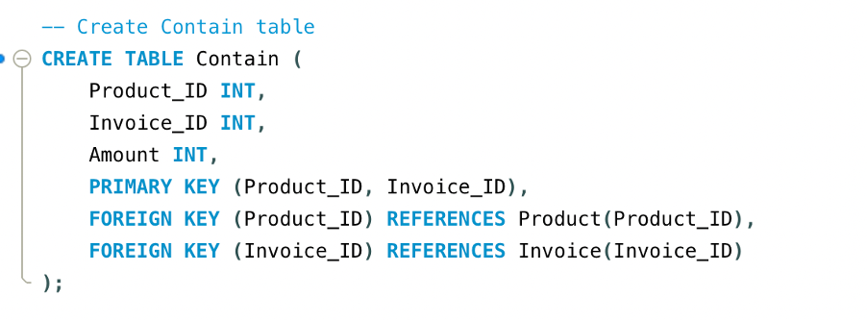
2.3 Create Table

Slide 12
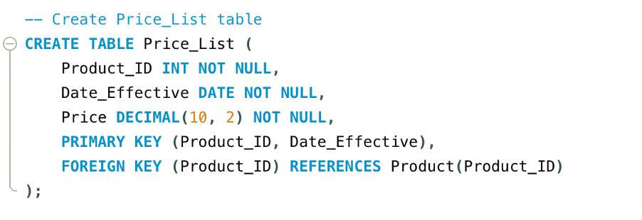
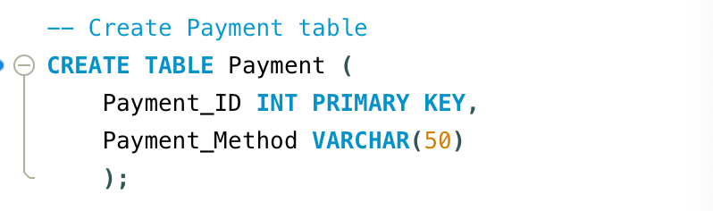
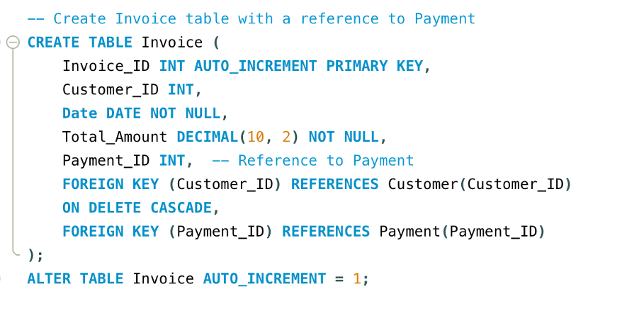

Slide 13
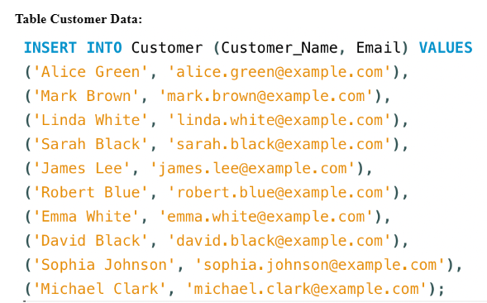
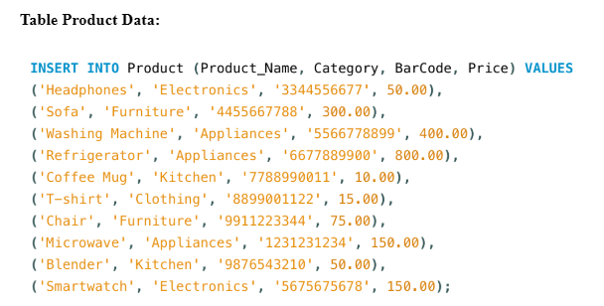
2.4 Database Data Insertion

Slide 14
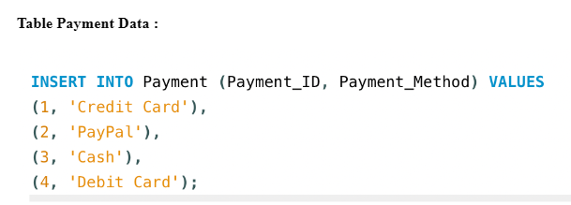
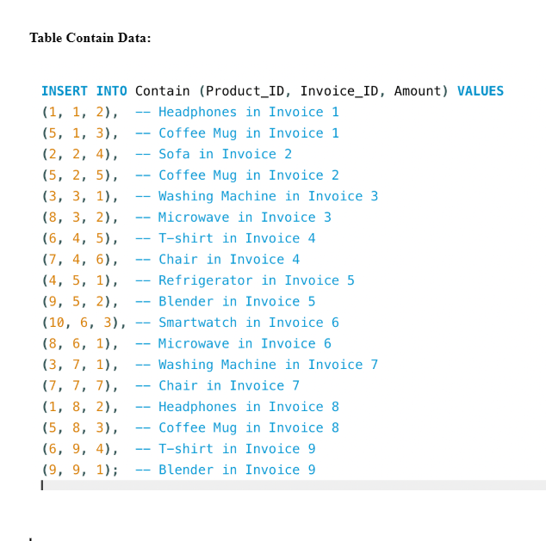
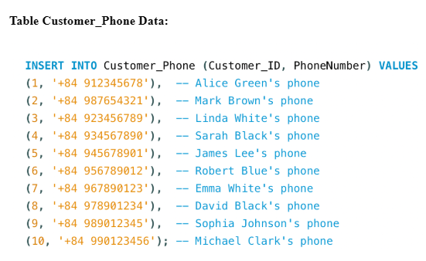

Slide 15
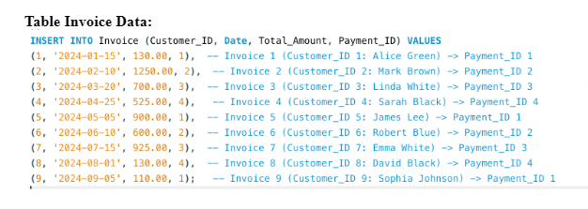
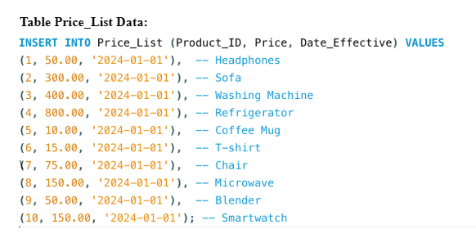

Slide 16

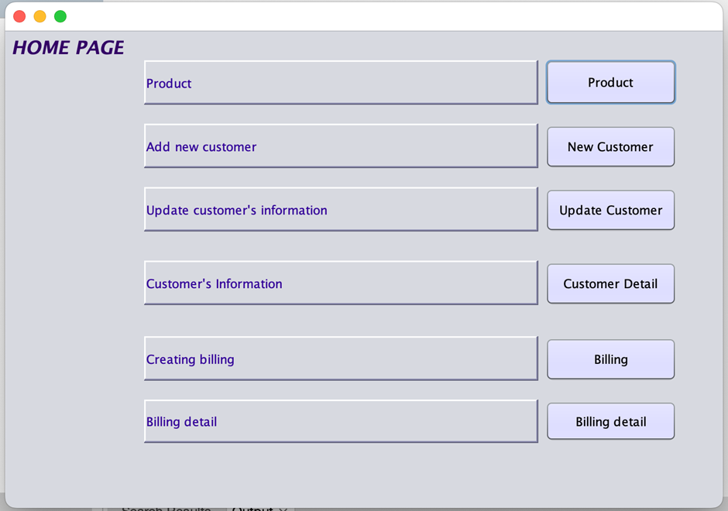

3.Application project structure
Key features:
Product Management
Customer Management
Invoice Generation
Billing and Reports

Slide 17
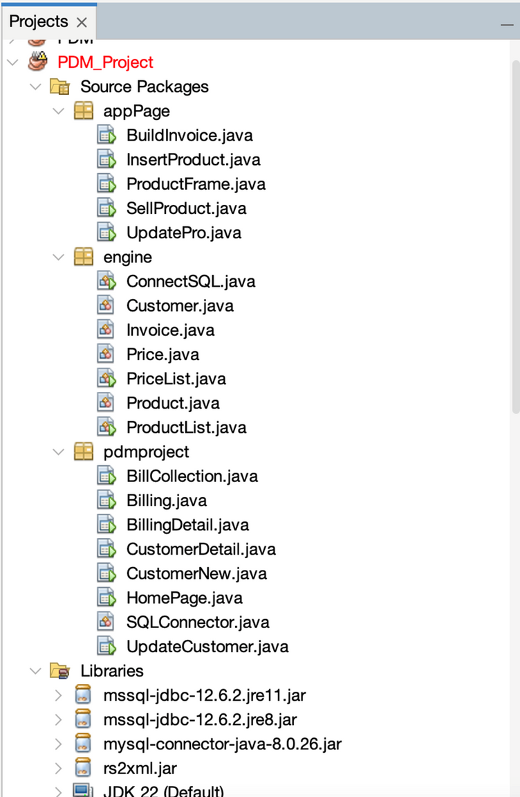
Main Components:
appPage Package: Handles user interface and interaction logic.
engine Package: Manages core system operations like database interaction and business logic.
pdmproject Package: Execute functions that calculate and operate on the database
Libraries:
JDBC drivers for MySQL
rs2xml.jar for generating reports

Slide 18
Home Page:
is the base page from which other functions can be selected and performed

Slide 19
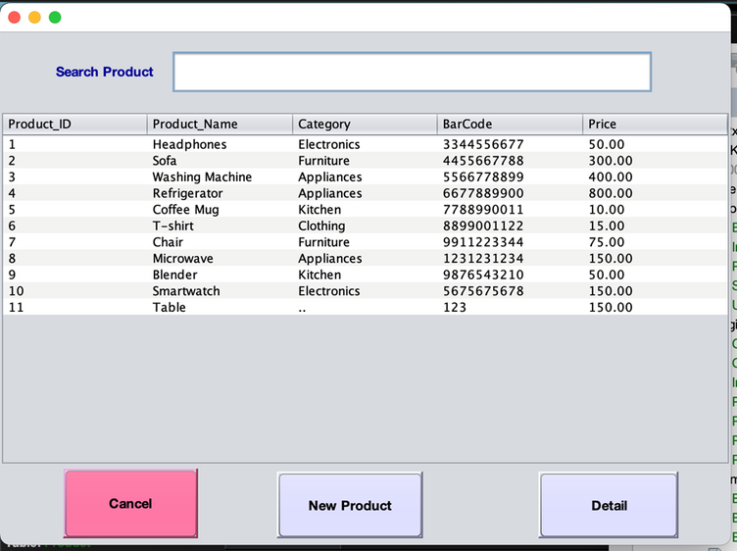
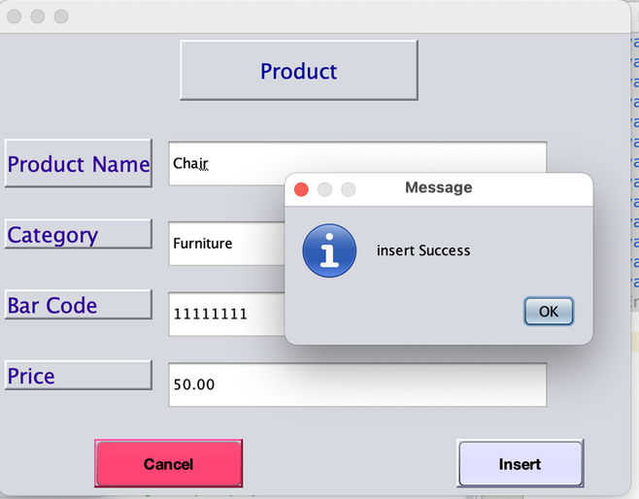
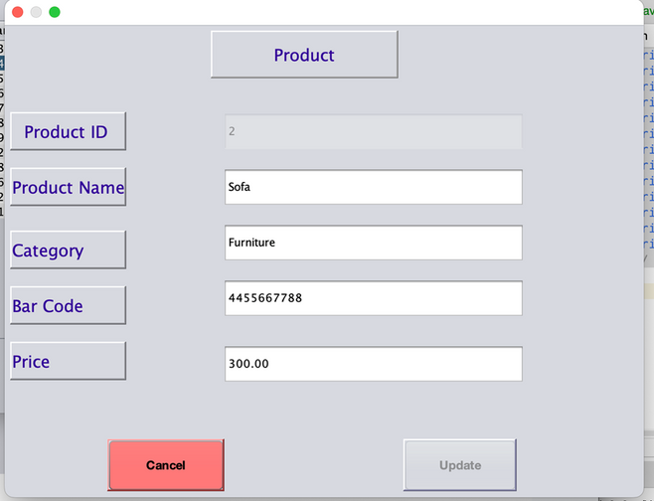
Product page:
admin can view information and update current products on this page
We also provide search by product name capabilities to enhance user experience

Slide 20
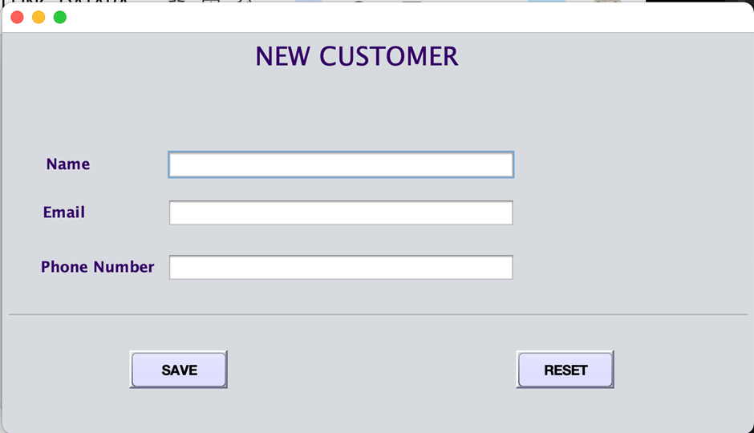
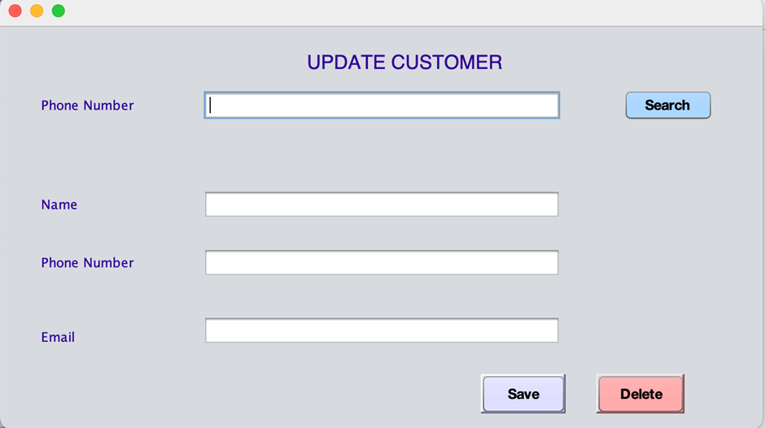
Customer page:
Simple and easy new user registration,
Provides the ability to search for users by phone number

Slide 21
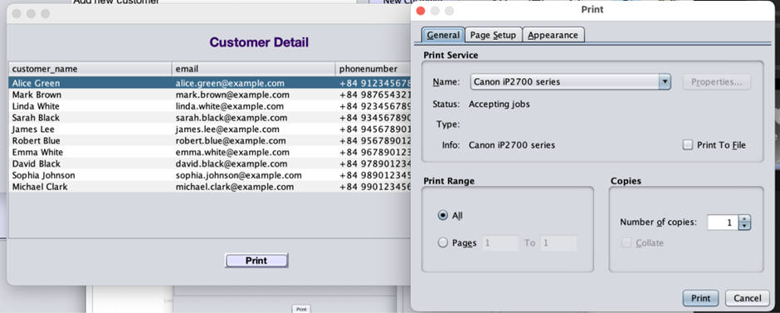
Customer page:
Simple and easy new user registration,
Provides the ability to search for users by phone number
Feature export user information as pdf

Slide 22
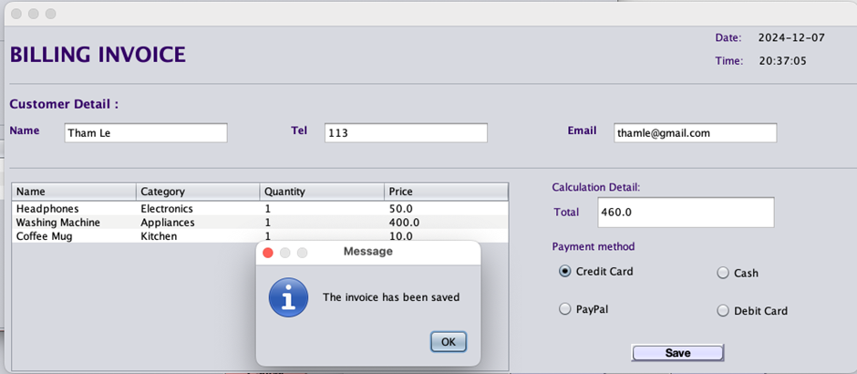
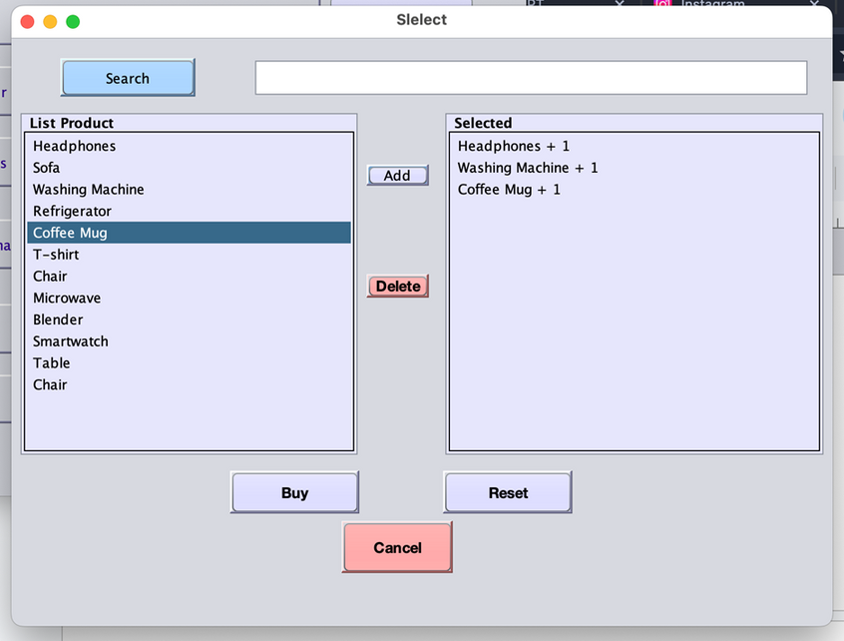
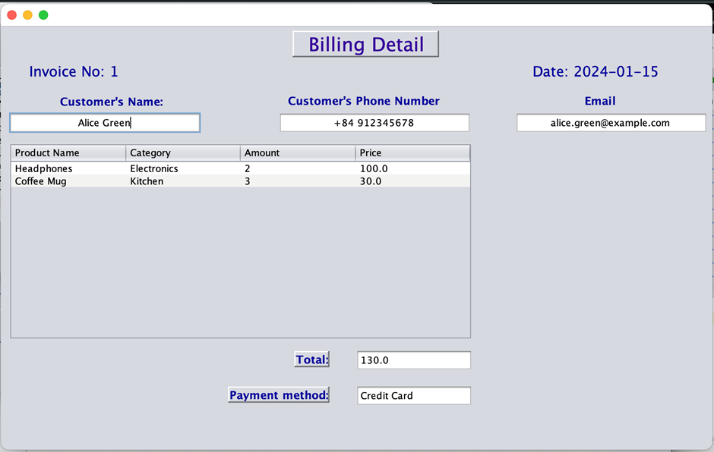
Generate bill:
The user will select the product to buy and the invoice will be created and generated automatically, all buyer information and payment methods will be managed and displayed intuitively.

Slide 23


Achieve Goals
The Invoice Billing Database project automates and streamlines billing processes for shopping complexes, improving efficiency, accuracy, and customer satisfaction. Key features include product information management, customer data tracking, invoice records, and keyword recognition.
Future Work
4.Conclusion
Integrating mobile applications, adding advanced analytics, enabling multi-language support, and migrating to cloud storage for scalability and disaster recovery.
System Analysis
Highlights functional requirements like detailed product, customer, and invoice management, along with non-functional needs for performance, scalability, and security. Challenges involve ensuring keyword recognition accuracy, real-time updates, and simplifying user training.

Slide 24
REFERENCES
01
SQL Server with NODE.JS:
02
Geeksforgeeks.org
03
Javatpoint

Slide 25

Thank you!

